Slide 1

Big Data Platform Final Project
Analyzing Reasons of Illinois Population Decline from News Articles
Prepared by Hairun “Helen” Wang
University of Chicago Graham School

Slide 2

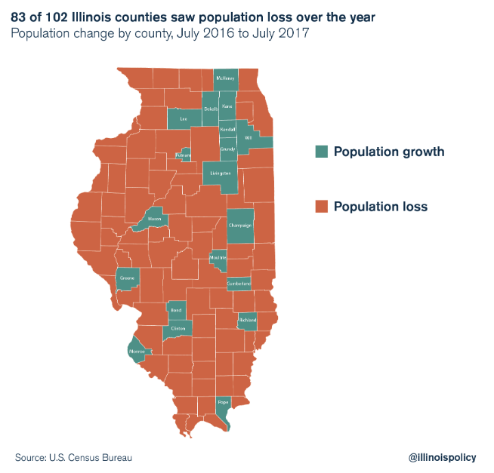
MSCA 32108 Autumn 2018
Business Problem
U.S. Census Bureau show Illinois’ concerning trends of population loss and outmigration are playing out at the county level across the state
The county-level data reveal 83 of Illinois’ 102 counties saw their population decline from July 2016 to July 2017
To tackle this issue, it’s critical to identify reasons for the population decline
Dataset Description & Approach
Used online news article related to Chicago or Illinois
Factor: News title and the content
Fundamentally, text data is unstructured. The goal is to extract some meaningful insights from news article using Natural Language Processing techniques
University of Chicago Graham School

Slide 3
MSCA 32108 Autumn 2018
Categories of News Article
company business experience stock service quarter job management report product research tool client market skill customer deloitte value program technology opportunity price sale buy financial
game season team play bear win yard run time week point year just second player make coach start cub state score big lead pass come football field touchdown bull end look defense g
Crime
Politics
Community/
Economics
police year officer shoot case attorney court charge kill shooting law judge murder official hospital trial file gun federal news crime death south investigation office victim block abuse release
trump city president election tell student vote run district percent campaign american republican right candidate public race mayor community rauner university woman support party world win pritzker
service offer park time ticket area home live free event food sale art code store open look october hotel lake just river restaurant location online mile price center video visit water follow design
Business/Tech
Sports
University of Chicago Graham School

Slide 4

MSCA 32108 Autumn 2018
Top Reasons for Population Decline
Conducted sentiment analysis and implemented further analysis on news article with negative sentiment
Generated both major topics and frequent words in those articles
Crime
Gun Shots
Murder
State Budget
Tax
University of Chicago Graham School

Slide 5
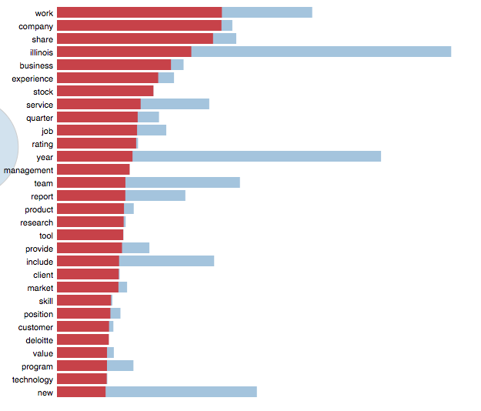
MSCA 32108 Autumn 2018
How Chicago/Illinois can attract new business
Prestigious colleges and universities
Highly educated talent pool
Top sports team in the nation
A great number of name brand businesses have operations in Illinois
University of Chicago Graham School

Slide 6
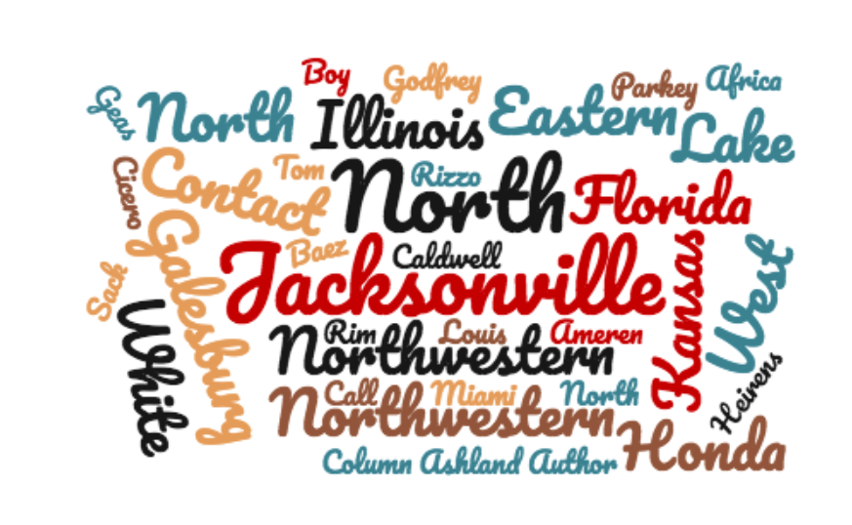
MSCA 31008 Autumn 2018
Why business or residents should stay or move into IL?
Many top notch universities are in Illinois which create a huge talent pool
Chicago is a tour city, which can stimulate economic consumption
Chicago has a great sports culture - Bulls, Bears, Cubs etc.
University of Chicago Graham School

Slide 7
MSCA 32108 Autumn 2018
Recommendations
Create, implement and monitor action plan for violence prevention
Promote sports culture in Chicago at the grassroots level
Reform tax policies, control government spending
Encourage local companies to create more jobs in order to avoid loss of population
University of Chicago Graham School

